Slide 1
Classifier
Bank Churn prediction

Slide 2
Problem Statement:-To predict the bank churn.
Dataset:-
The data contains 13 variables to predict the churn with 10,000 customers observations.
Target columns:-Exited

Slide 3
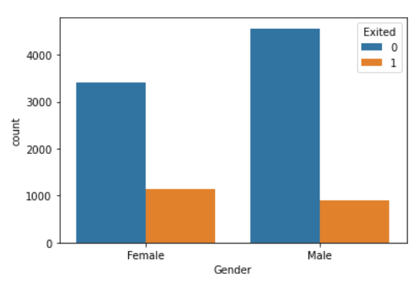
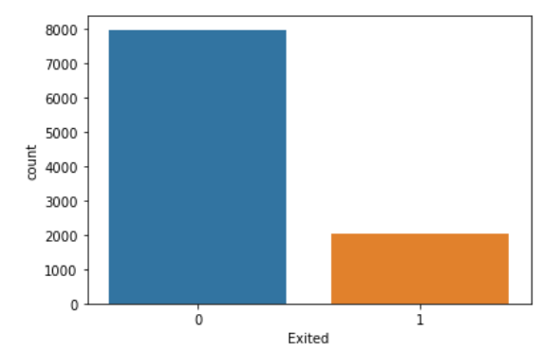

Data Exploring:-
Out of 10,000 ,2037 customers have churned i. e approx. 20% .
Compare to male , the count for female is higher in leaving the bank.

Slide 4
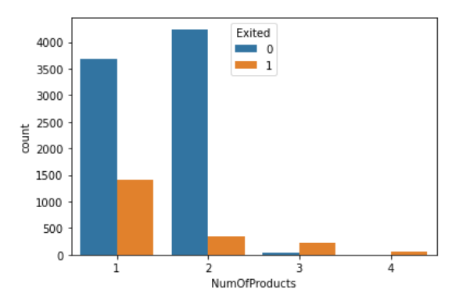
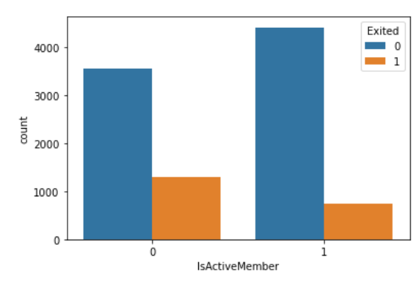
Customers with one ,single product are leaving the bank more
The Churning rate for the inactive member is more.

Slide 5
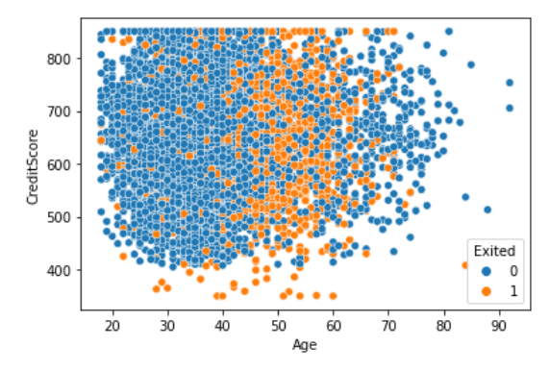
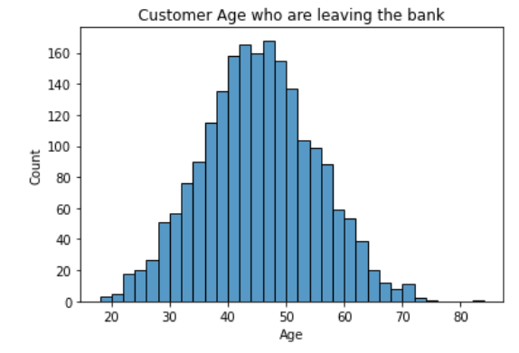
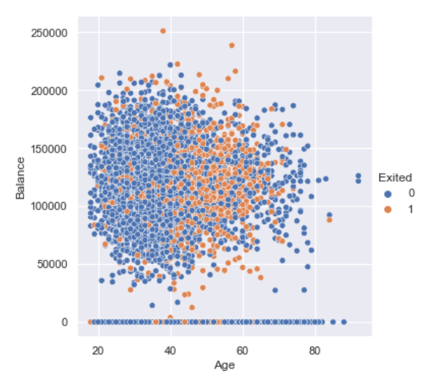
There is no impact of the credit score or of the balance on customer leaving the bank . Customer with higher balances are also churning.
Customer from the age of 40 to 55 are leaving the bank more.

Slide 6
Treatment:-
1-There are no outliers.
2-Label encoding-for column Gender.
3-Scaling-Scaling using Standard Scaler for the train data.
4-Splitting –Using train test split.
5-Cross validation-Stratified Kfold.

Slide 7
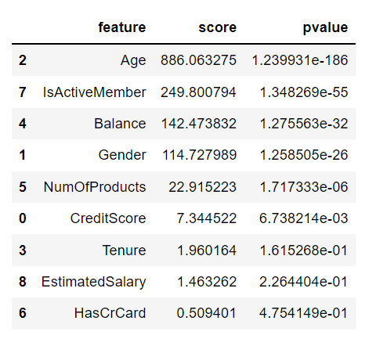
Feature Selection:-(f_classif function)
1-Age
2-Is Active Member
3-Balance
4-Gender
5-CreditScore
6-Number of Products

Slide 8
Different model (f1Score) with all the columns:-
Model | 80:20 (split) | 70:30 (split) | 60:40 (split)
Logistic Regression | 10.68% | 10.04% | 9.58%
Naïve Bayes | 14.62% | 15.69% | 14.04%
Decision Tree | 48.17% | 48.37% | 47.86%
AdaBoost | 55.58% | 53.79% | 54.54%
Random Forest | 55.38% | 53.99% | 54.13%

Slide 9
Models(f1 Score) with feature selection:-
Model | 80:20 (split) | 70:30 (split) | 60:40 (split)
Logistic Regression | 10.23% | 8.93% | 8.75%
Naïve Bayes | 14.49% | 14.51% | 12.19%
Decision Tree | 47.11% | 47.34% | 49.20%
AdaBoost | 54.97% | 52.23% | 53.32%
Random Forest | 56.89% | 55.75% | 56.27%

Slide 10
Best result we are getting with 80:20 split and with feature selection.
Best model:-
Model | F1-score | CV score | AUC score | True cases prediction
Logistic Regression | 10.23% | 9.97% | 51% | 1561
Naïve Bayes | 14.49% | 12.18% | 51.4% | 1555
Decision Tree | 47.11% | 46.38% | 66.1% | 1556
AdaBoost | 54.97% | 55.62% | 70% | 1692
Random Forest | 56.89% | 53.64% | 71% | 1699

Slide 11
Best Model:-
The f1 Score of the random forest is higher.
The better the AUC score the better is the correct prediction .So for the Random Forest the AUC score is higher.
Random Forest has predicted the highest true cases , out of 2000 ,1699 were correctly predicted.
On the basis of f1-score,AUC and true predicted cases the Random Forest is the best model.

Slide 12
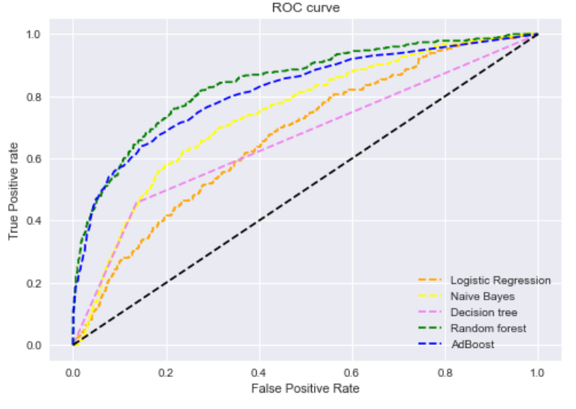

Slide 13
Conclusion:-
The customer at the age of the 40 to 60 are churning at a higher rate. The bank need to improve the service and make the strategy for this age group customer.
We can see that the customer with the higher balances are also leaving the bank. Bank should try to offer some higher interest on the saving account for this kind of customer.
More females are churning. Bank should provide some special benefit for the females, specially locker discount with the saving account with a low MAB.
Customer with one product are leaving the bank more, so the bank should try to sell one or more products to the customer with some benefits.
More inactive customer are leaving the bank . So the bank should try to conduct the some survey and make the inactive customer active.

Slide 14
Thank You

